Slide 1
FPGA components
CE233(CAD), Lecture 7:
Mehdi Modarressi
Department of Electrical and Computer Engineering,
University of Tehran

Slide 2
Reading:
  Spartan-3 Generation FPGA User Guide, Xilinx ug331 (v1.8)
  “FPGA Prototyping By VHDL Examples- Xilinx Spartan-3 Version”, Chapter 2
  “The Design Warrior's Guide to FPGAs”, Chapter 4

Slide 3
FPGA components
Configurable Logic Blocks (Lecture 5)
Interconnects (Lecture 6)
Carry-chain
Block RAM
Dedicated multipliers
Programmable Input Output Blocks (IOB)
Clock manager

Slide 4
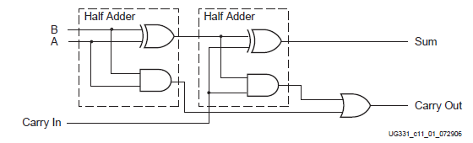
CLB arithmetic logic
Adder is the base of many arithmetic operations
Special logic in CLBs to implement adder
Adders are traditionally constructed by cascading full adders
Good modularity but long latency due to the serial operation
  Carry must be propagated from the first to the last full adder: the n^{th.} adder cannot start until the carry of the n-1^{th.} full adder is calculated

Slide 5
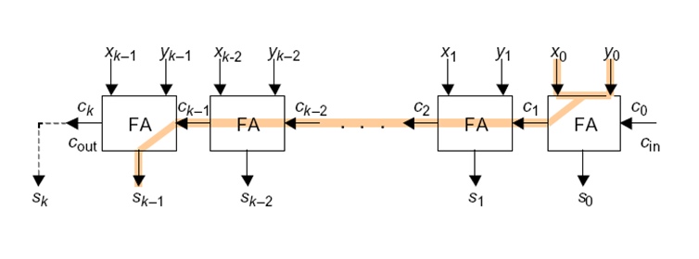
Ripple carry adder
Critical path in a k-bit ripple carry adder
Source: ECE 645, Lecture 3

Slide 6
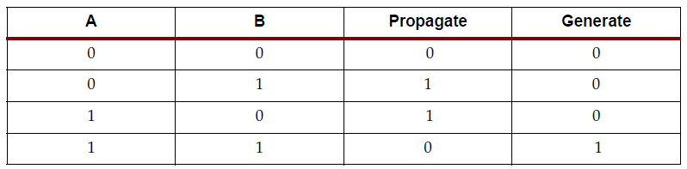
CLB arithmetic logic
We can predict the carry of each full adder (FA) from its inputs
If a=b=0, no carry will be produced by the FA (regardless of the carry_in)
If a=b=1, a carry will be produced by the FA (regardless of the carry_in)
If a≠b, the input carry will be propagated to the output

Slide 7
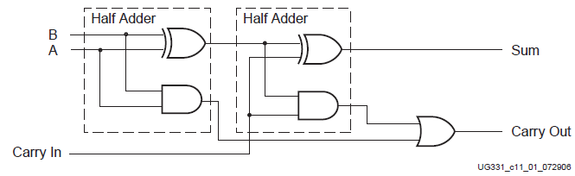
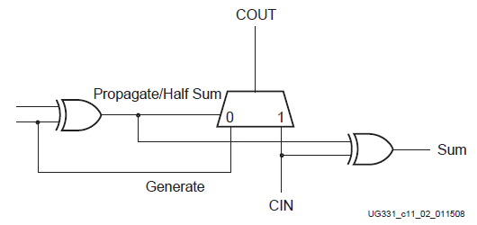

Carry look-ahead adder
Conventional serial full adder
Full-adder with carry look-ahead Implemented in SPARTAN-3

Slide 8
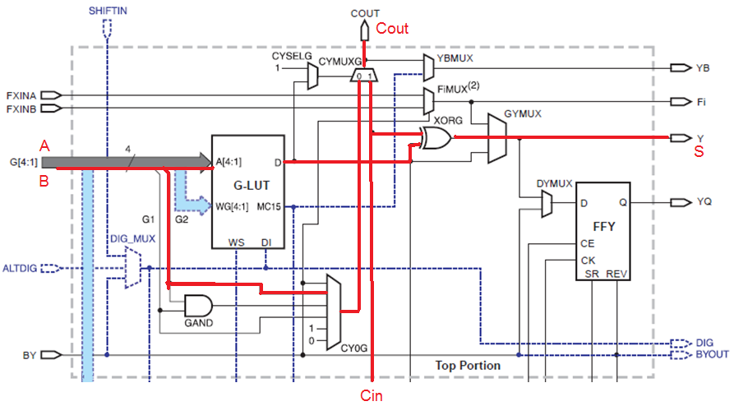
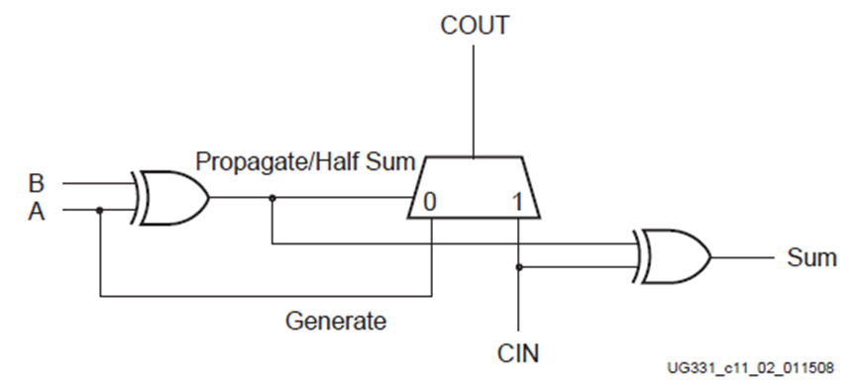
Carry look-ahead adder in SPARTAN
Adder data-path in one slice
Implements an FA to add two 1-bit inputs A and B

Slide 9
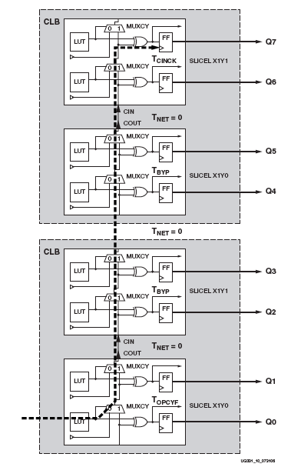
Adder by Spartan-3
8-bit adder using 4 slices of Spartan-3
Source: ECE 645, Lecture 3

Slide 10
Carry Chain in Artix-7
Carry chain can implement fast arithmetic addition and subtraction
  Carry out is propagated vertically through the four LUTs in a slice
  The carry chain propagates from one slice to the slice in the same column in the CLB above
Carry look-ahead
  Combinatorial carry look-ahead over the four LUTs in a slice
  Implements faster carry cascading from slice to slice
LUT/RAM/SRL
LUT/RAM/SRL
LUT/RAM/SRL
LUT/RAM/SRL
0 1

Slide 11
FPGA components
Configurable Logic Blocks (Lecture 5)
Interconnects (Lecture 6)
Carry-chain
Memory
Dedicated multipliers
Programmable Input Output Blocks (IOB)
Clock manager

Slide 12
Memories
On-chip storage on the FPGA:
  reduces system costs
  allows for a wider, faster memory interface
  reduces I/O demands
There are two ways of implementing memory on FPGAs:
  embedded memory (large fixed dedicated memory blocks)
  distributed memory (small memories spread across the entire FPGA chip)

Slide 13
Distributed RAM
RAM32X1b
A LUT in a SLICEM may be configured for use as a RAM
  Implement single and dual port
  Cascade LUTs to increase size
Synchronous write only
Reads may be synchronous
or asynchronous.
D
WE
WCLK
A0
O
A1
A2
LUT
A3
A4
or
=
LUT
RAM16X2b
D0
D1
RAM16X1b
WE
LUT
D
WCLK
O0
WE
A0
O1
=
WCLK
A1
A0
O
A2
A1
A3
A2
A3
13
Source: EE178 Lecture 4, by T. Cauhuu

Slide 14
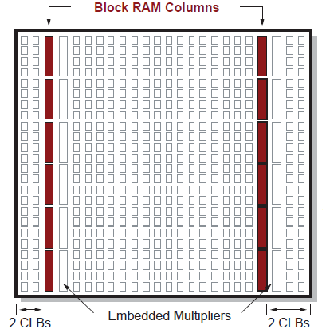
Block RAM
On-chip memory blocks of Static RAM
Both single and dual-port memories
XC3S400 has two columns of RAM
Each column contains 8 blocks of RAM (the figure shows 6 blocks!)
Each block is 18-kilobit synchronous RAM
  Each block has 16 kb data, 2kb parity
  Total RAM=18 kb×16 blocks= 288 kb

Slide 15
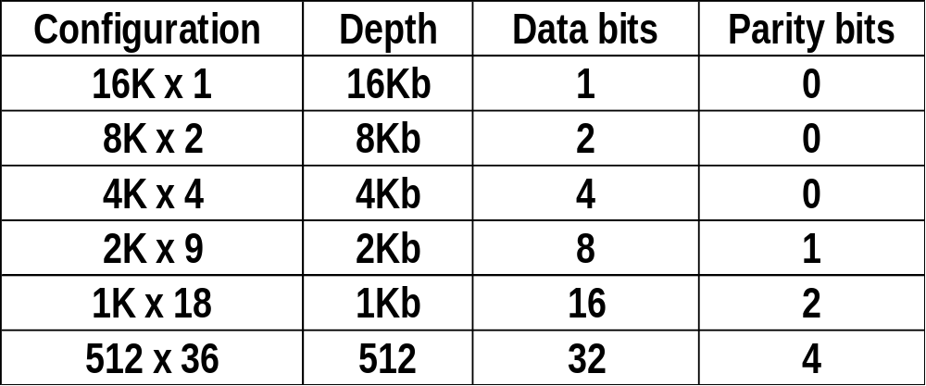
Block RAM organization
Can be used as RAM blocks with different lengths and widths
2kb of the RAM is devoted to parity bits
16Kx1 configuration can be used as a large lookup table

Slide 16
FPGA components
Configurable Logic Blocks (Lecture 5)
Interconnects (Lecture 6)
Carry-chain
Memory
Dedicated multipliers
Programmable Input Output Blocks (IOB)
Clock manager

Slide 17
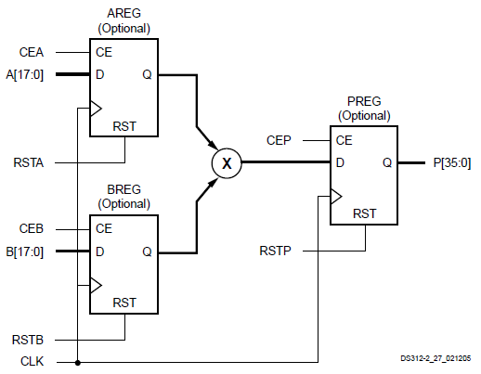
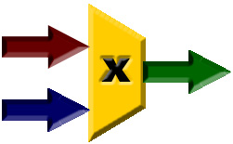
Multiplier
18×18 multipliers
Very fast: single cycle latency
16 multipliers in Spartan-3
Can use registers in input and output of each multiplier
  For pipelined operation
18 Bit
36 Bit
18 Bit

Slide 18
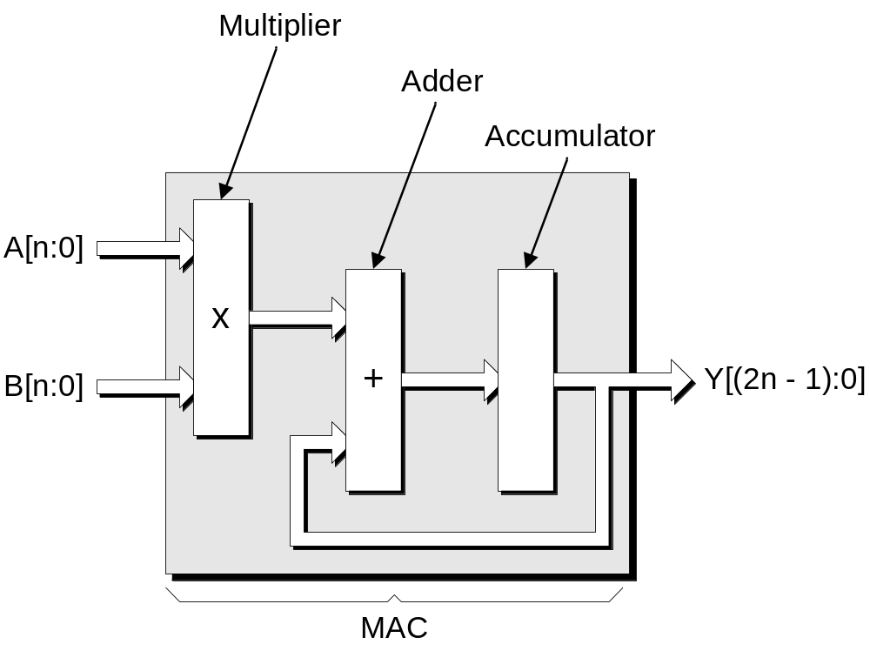
DSP block
In 7-series, we have Multiply and accumulate (MAC), instead of simple multiplier

Slide 19
FPGA components
Configurable Logic Blocks (Lecture 5)
Interconnects (Lecture 6)
Carry-chain
Memory
Dedicated multipliers
Programmable Input Output Blocks (IOB)
Clock manager

Slide 20
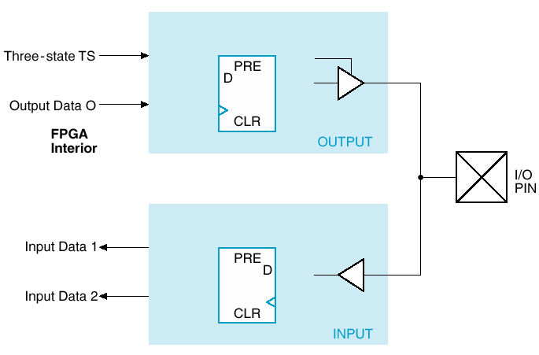
I/O resources
I/O pins
Can be configured as both input and output
I/O pins have different architectural and electrical aspects
  The most interesting aspect is the double data rate capability
Basic I/O block
More complex blocks in reality

Slide 21
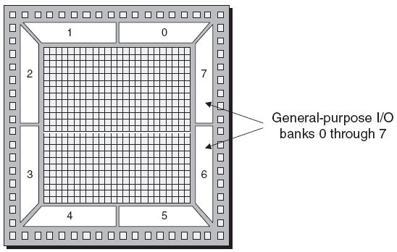
Configurable I/O Standards

Slide 22
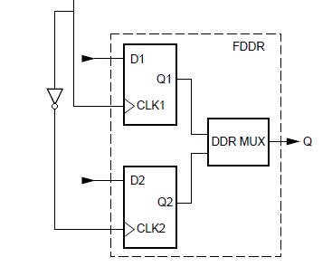
Spartan-3 I/O- DDR
Double-Data-Rate (DDR) transmission describes the technique of sending data on both the rising and falling edges of the clock
Doubles the bandwidth

Slide 23
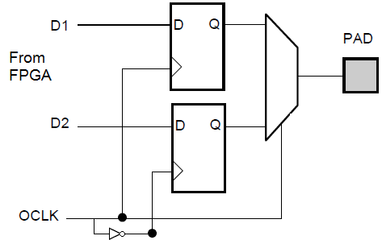
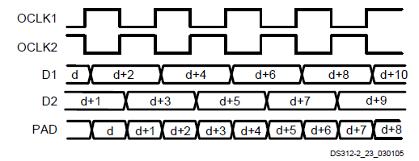
Spartan-3 I/O- DDR

Slide 24
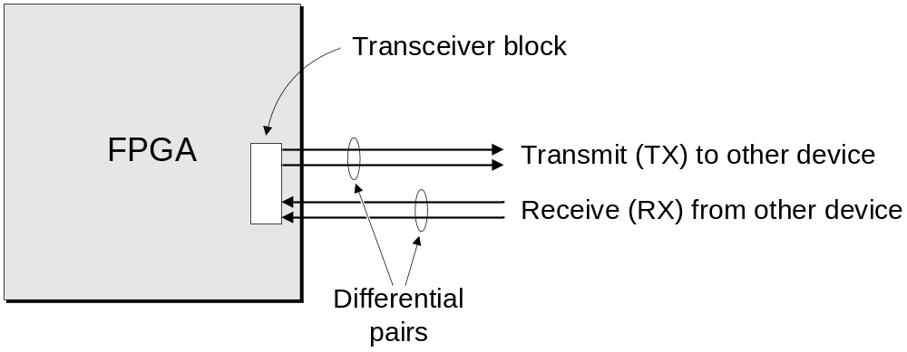
Gigabit Transceiver
Modern FPGAs have dedicated Transceiver blocks for high-speed communication
Source: The Design Warrior’s Guide to FPGAs Devices, Tools, and Flows. ISBN 0750676043

Slide 25
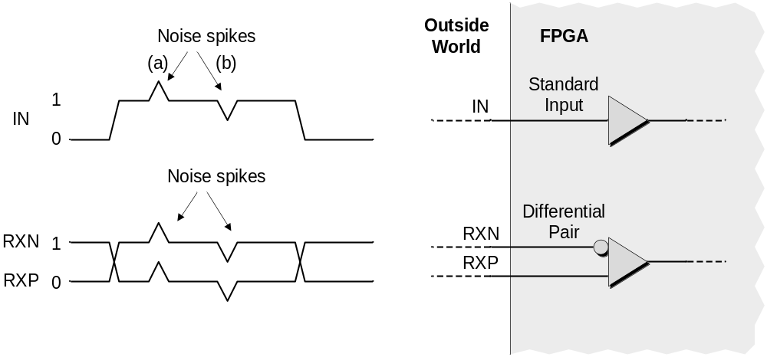
Why differential signalling?
Source: The Design Warrior’s Guide to FPGAs Devices, Tools, and Flows. ISBN 0750676043

Slide 26
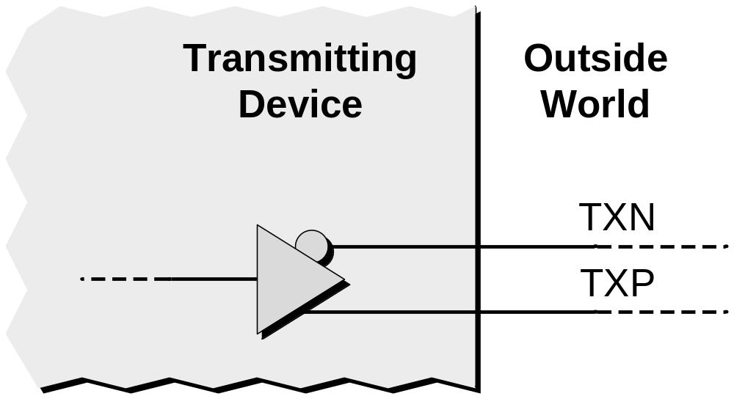
Generating a Differential Pair
Source: The Design Warrior’s Guide to FPGAs Devices, Tools, and Flows. ISBN 0750676043

Slide 27
I/O pins
In addition to more CLBs, modern families has more I/O pins
Most Spartan 3 FPGAs have QFP package(or some variant of it)
Modern FPGA have BGA package(or some variant of it)
What is BGA? QFP?

Slide 28
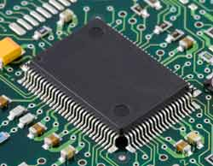
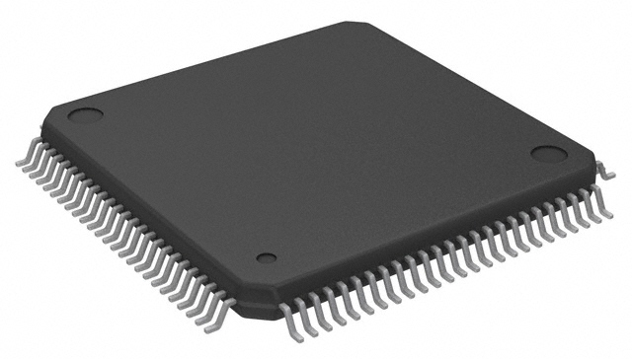
QFP
Quad Flat Package
Pins are on each of the four sides of the chip
Limited number of pins, but easier to mount on board

Slide 29
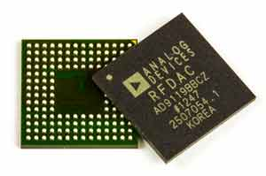
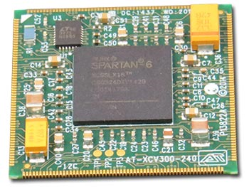
BGA
Ball Grid Array
Pins are placed on the whole bottom surface of the device, instead of just the perimeter.
More pins, but hard to solder and mount on board

Slide 30
FPGA components
Configurable Logic Blocks (Lecture 5)
Interconnects (Lecture 6)
Carry-chain
Memory
Dedicated multipliers
Programmable Input Output Blocks (IOB)
Clock manager

Slide 31
Clock in FPGAs
All of the synchronous elements inside an FPGA need to be driven by a clock signal.
Such a clock signal typically originates in the outside world, comes into the FPGA via a special clock input pin, and is then routed through the device and connected to the appropriate registers.

Slide 32
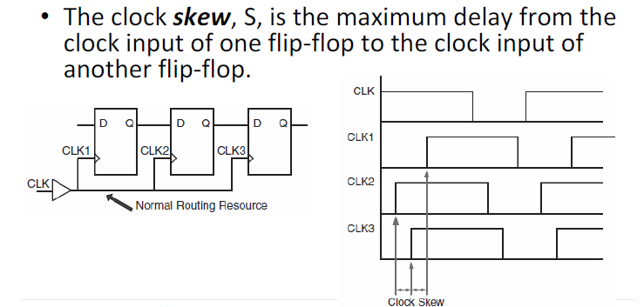
Clock in FPGAs
Clock skew is an important problem in clock distribution

Slide 33
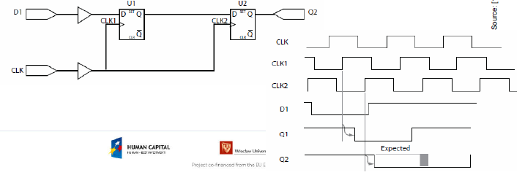
Clocking in FPGAs- skew problem
Clock skew is an important problem

Slide 34
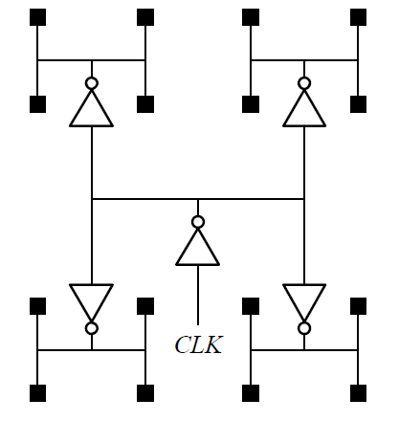
Skew solution
Don’t use gated clocks
Balance clock paths (tree distribution)
The most common way: H-tree:
  All FFs (black squares)
receive clock at the same time

Slide 35
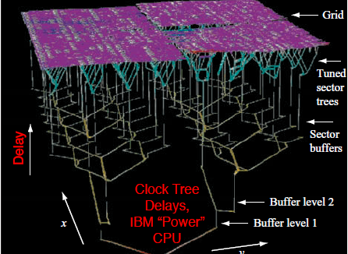
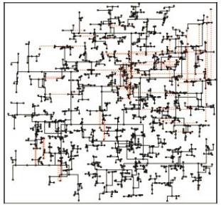
Realistic H-trees

Slide 36
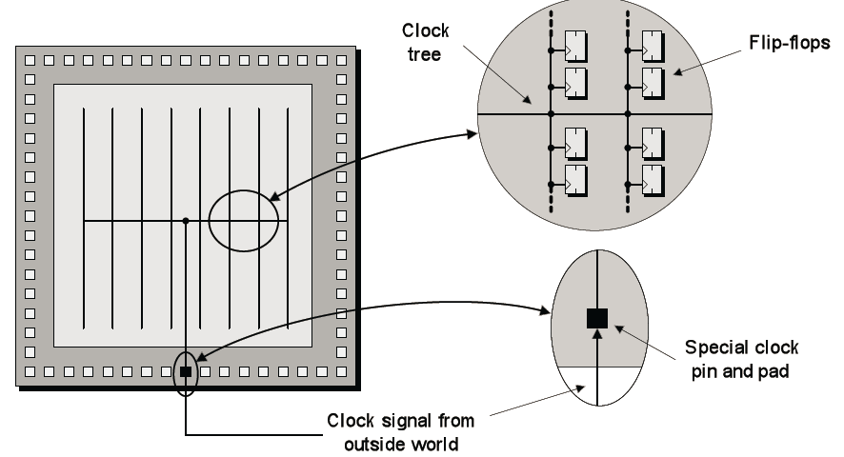
FPGA clock tree

Slide 37
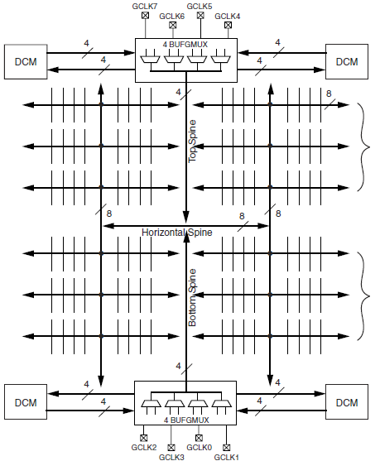
Spartan-3 clock tree
Spartan-3 devices have eight Global Clock input pads called GCLK0 through GCLK7
The eight BUFGMUX components (4 at the top and 4 at the bottom side) can multiplex between clock sources
  From input pins or from DCMs

Slide 38
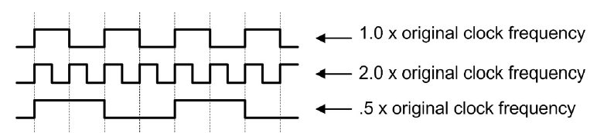

Digital Clock Manager (DCM)
Used to generate clock signal for FPGA out of the external clock signal
Phase Shift a clock signal
Multiply or divide an incoming clock frequency or synthesize a completely new frequency by a mixture of clock multiplication and division
Phase shift

Slide 39
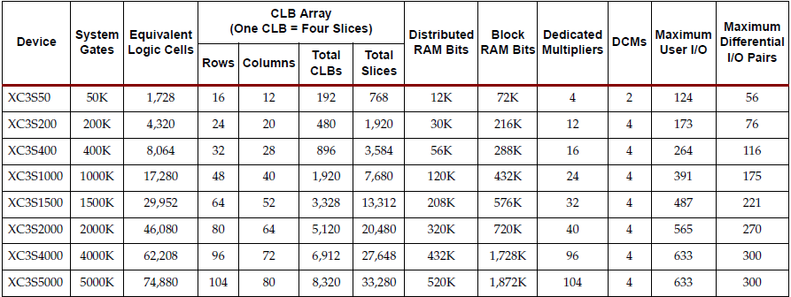
Old FPGAs
Spartan-3
Source: Spartan-3 Generation FPGA User Guide, Xilinx ug331 (v1.8)

Slide 40
Logic cell
Logic cell: LUT + Flip-flop
The additional features in a slice, such as the wide multiplexers, carry logic, and arithmetic gates, add to the capacity of a slice
  Implementing logic that would otherwise require additional LUTs
Benchmarks show that the overall slice is equivalent to 2.25 simple logic cells
Source: Spartan-3 Generation FPGA User Guide, Xilinx ug331 (v1.8)

Slide 41
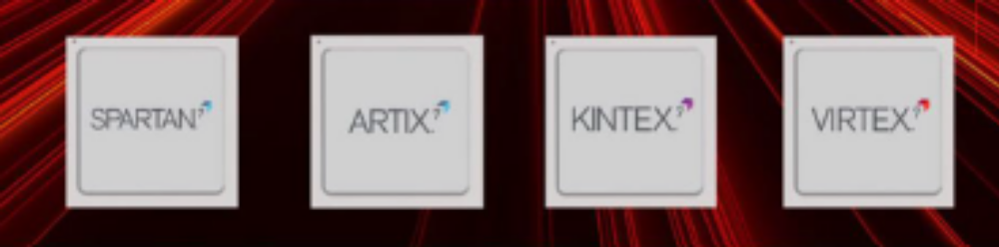
Modern Xilinx FPGAs
Virtex: high capacity (up to 2M logic cells), high-performance
Kintex: high performance, but smaller than Virtex
Artix: mid-range, low-cost and low-power
Spartan: low-end

Slide 42
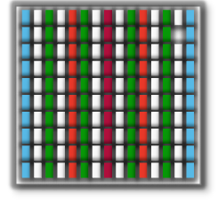
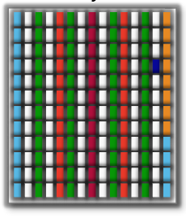
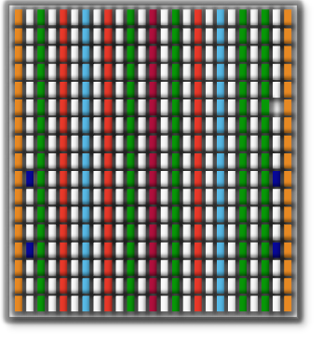
Modern Xilinx FPGAs
All 7 series families share the same basic building blocks
The mixture and number of these resources varies across families
Artix™-7 FPGA
Logic Fabric
LUT-6 CLB
Precise, Low Jitter Clocking
MMCMs
Kintex™-7 FPGA
On-Chip Memory
36Kbit/18Kbit Block RAM
Enhanced Connectivity
PCIe® Interface Blocks
DSP Engines
DSP48E1 Slices
Hi-perf. Parallel I/O Connectivity
SelectIO™ Technology
Hi-performance Serial I//O Connectivity
Transceiver Technology
Virtex®-7 FPGA
Notes:
All 7 series families share the same basic building blocks. The mixture and number of these resources varies across families.

Slide 43
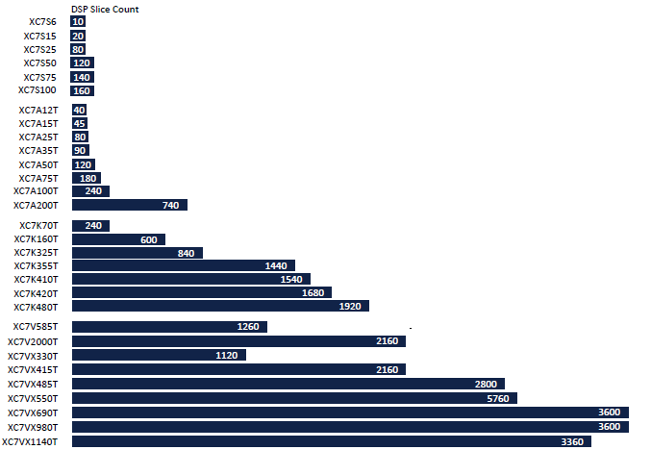
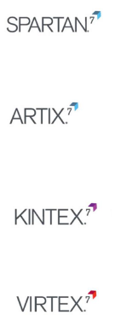
Modern Xilinx FPGAs- DSP blocks
~15 $
~35 $
~180 $
~20,000 $
Source: Xilinx 7-series product guide, xmp101

Slide 44
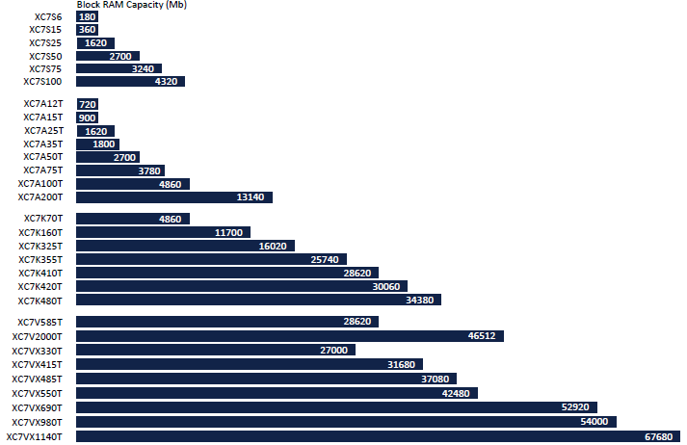
Modern Xilinx FPGAs- memory

Slide 45
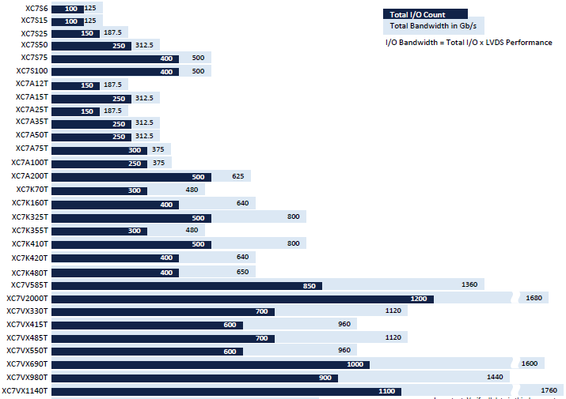
Modern Xilinx FPGAs- IO pins

